Slide 1

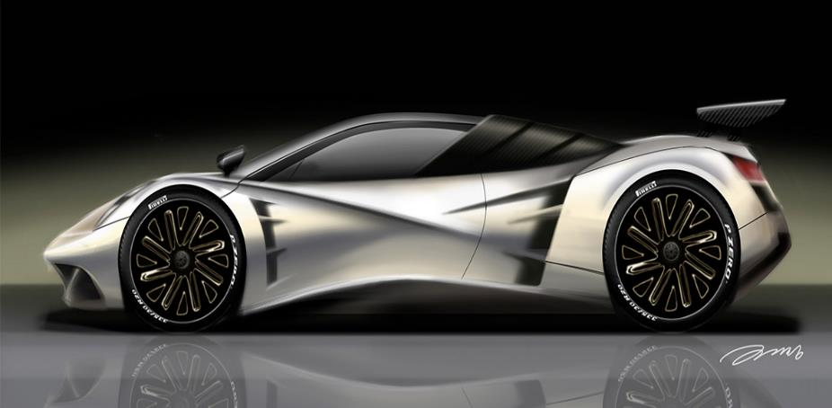
Vehicle Security
by
Amara Dinesh Kumar
For future !
Notes:
To use this title animation slide with a new image simply 1) move the top semi-transparent shape to the side, 2) delete placeholder image, 3) click on the picture icon to add a new picture, 4) Move semi-transparent shape back to original position, 5) Update text on slide.

Slide 2
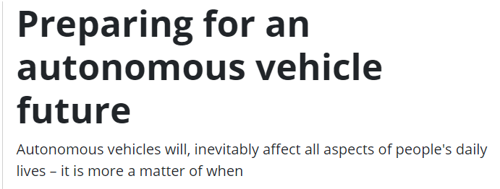
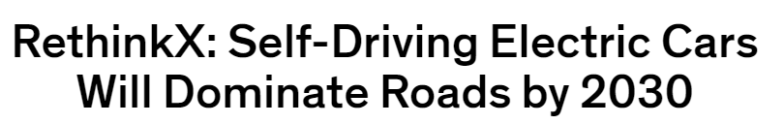


Slide 3
INTRODUCTION
We have to Make Cars Safe and Secure for Future
We will discuss possible attacks, exploits and vulnerabilities on autonomous vehicles
Automobile industry is going to take the biggest leap in history
Get ready for Brain Storming..!!!

Slide 4
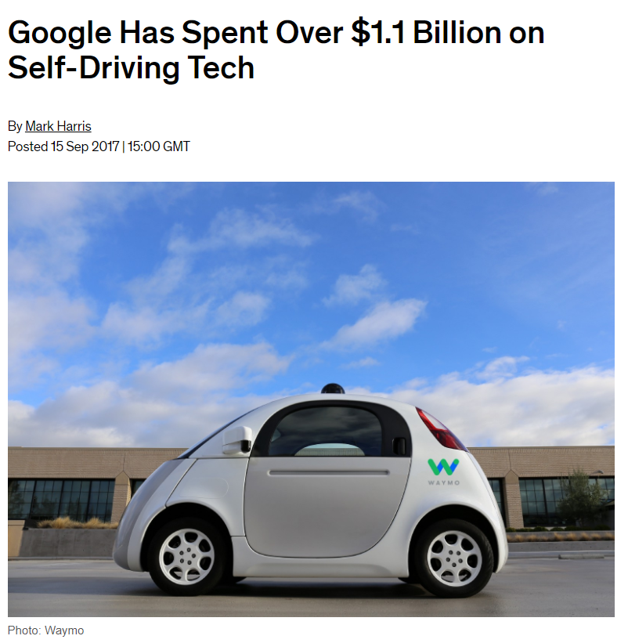
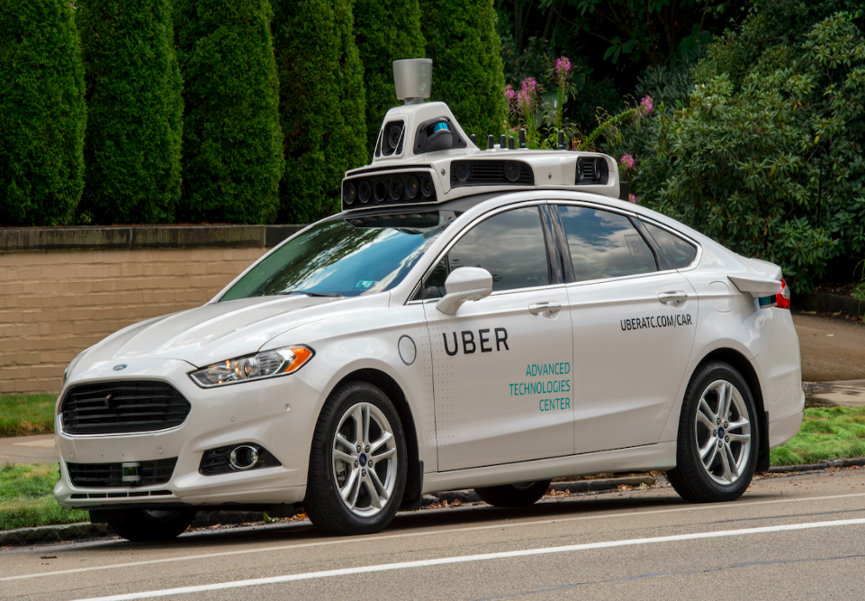
1. Introduction

Slide 5
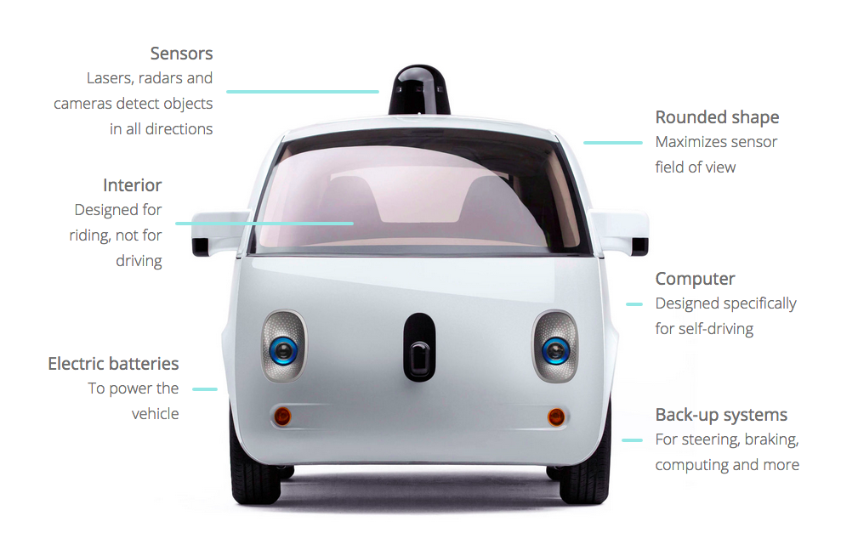
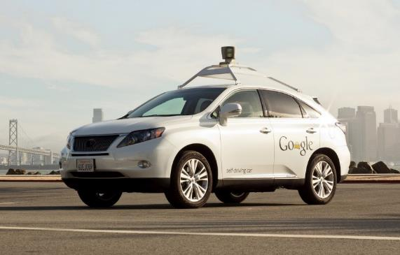
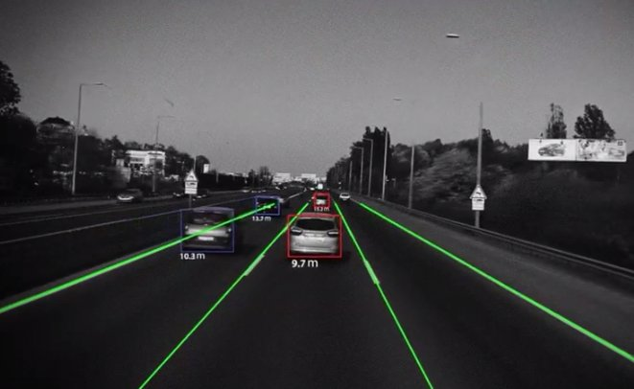
Motivation
Variety of systems, often working in concert:
Radar and Lidar
Motion sensors
Computer vision
Image processing
Neural network prediction
Google
Mobileye
Notes:
(CLICK) Currently there are a number of different systems - usually integrated - that can enable a car to drive itself.
These include:
Radar and Lidar
Motion sensors
and Computer Vision.
(CLICK)
My project focused only on Computer Vision, and specifically two techniques: IMAGE PROCESSING and NEURAL NETWORKS

Slide 6
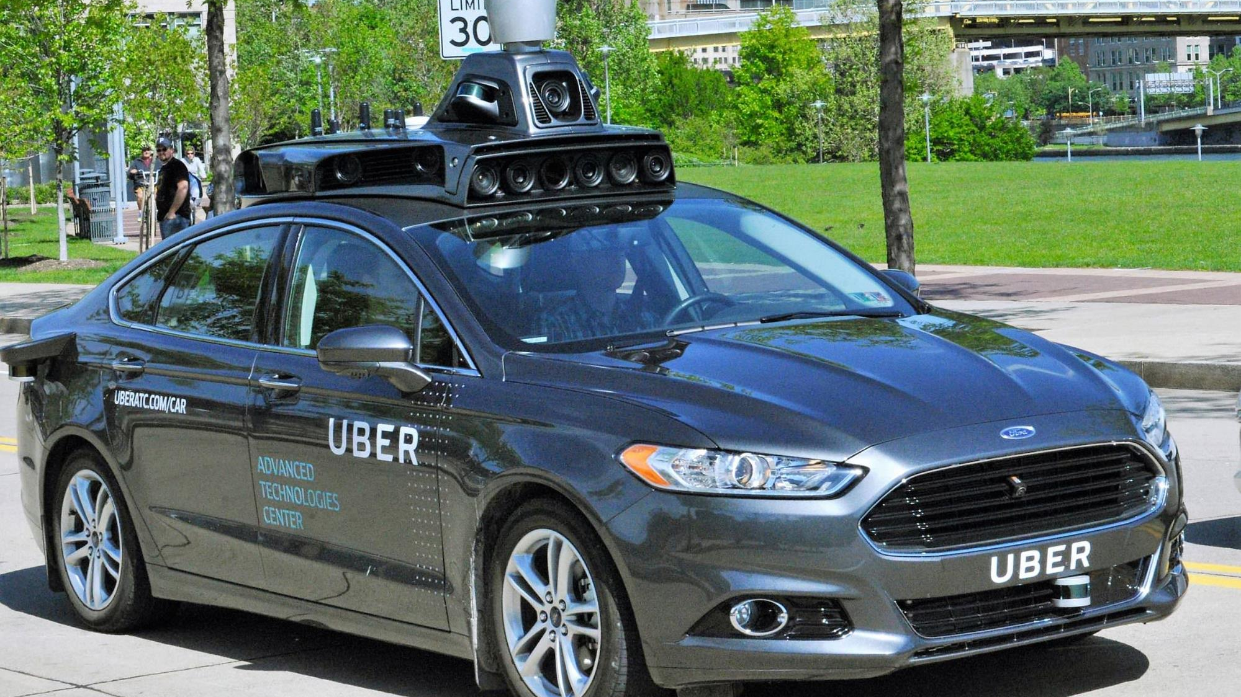
1.1. Why are autonomous vehicles more vulnerable to attacks?

Slide 7
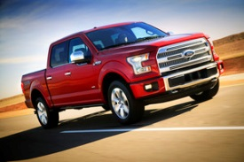
It’s Complicated
Example: the new Ford F150 pickup has 150 million lines of code
Each vehicle has multiple Electronic Control Units (ECUs) from different vendors
Presents multiple attack points for hackers
Complexity is the enemy of security
http://www.informationisbeautiful.net/visualizations/million-lines-of-code/

Slide 8
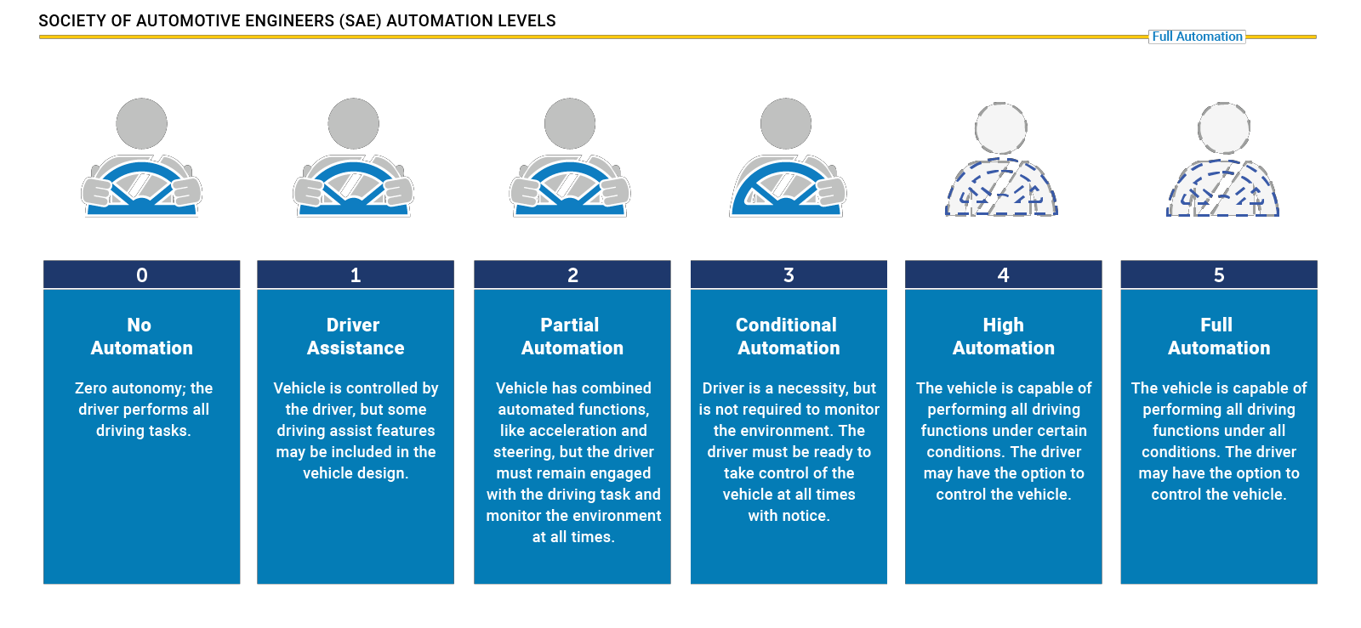
SAE Levels of Automation
Source: https://www.nhtsa.gov/technology-innovation/automated-vehicles-safety

Slide 9
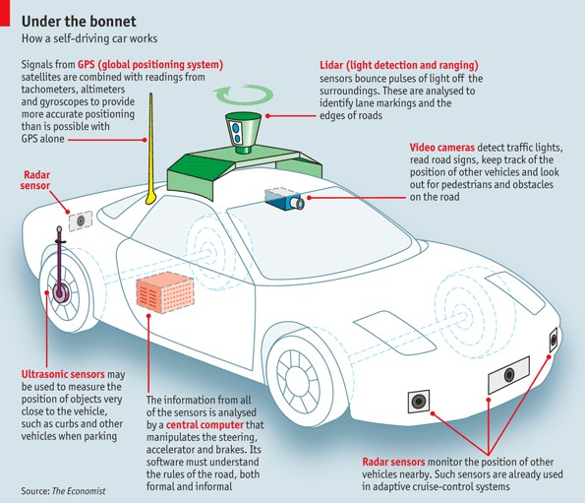
Basic Physical Ecosystem of an Autonomous Vehicle
Global Positioning System (GPS)
Light Detection and Ranging (LIDAR)
Cameras (Video)
Ultrasonic Sensors
Central Computer
Radar Sensors
Dedicated Short-Range Communications-Based Receiver (not pictured)
Source: The Economist, “How does a self-driving car work?”

Slide 10
Different types of attacks possible
1
2
3
4
5
Sensors
Vehicle Networks
Hardware attacks
Adversarial Attacks
Miscellaneous Attacks
Wait we will discuss !!!
Reference : The basics you can find anywhere 5 Steps To Successful Storytelling Published on April 5, 2014 Featured in: Marketing & Advertising

Slide 11
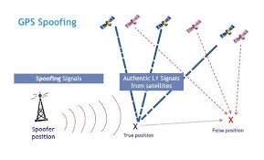
2. Attacks exploiting the vulnerabilities in various sensors of vehicle
2.1. Global Positioning System (GPS)
Misleading of the GPS signals is known as GPS spoofing and jamming where hackers transmit the unrealistic signal/data. The strength of the unrealistic signal increases as the GPS receivers are programmed to receive the stronger signals and gradually the position of the vehicle is modified from the desired target
For more details: https://www.microsoft.com/en-us/research/uploads/prod/2018/06/security18gps.pdf
2.2. Inertial Measurement Unit (IMU)
IMU is the combination of the Gyroscope and Accelerometers which provides the data of velocity, acceleration, and orientation of the vehicle.

Slide 12
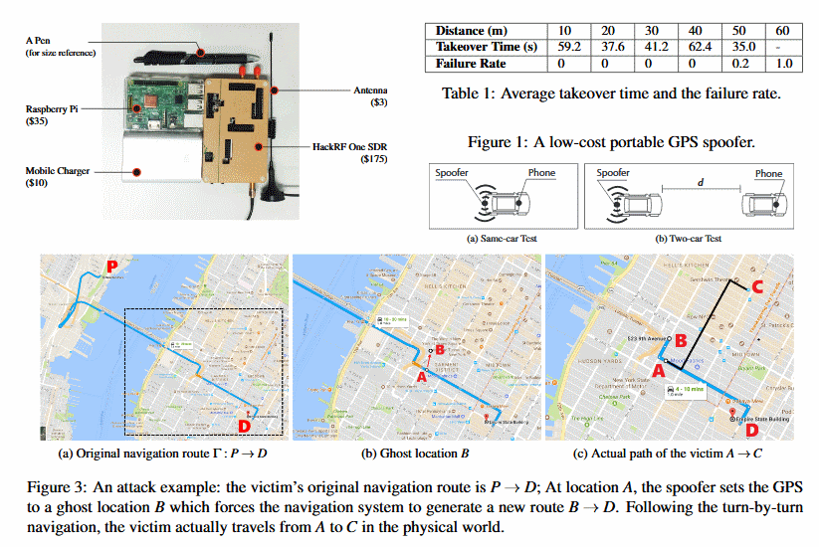

Slide 13
2. Attacks exploiting the vulnerabilities in various sensors of vehicle
2.3. Light Detection and Ranging (Lidar)
Light Detection and Ranging (LiDAR) is used to localize the environment, obstacle detection, and avoidance. It based on the technology, time taken by the light to travel to and fro to the vehicle determine’s the distance at which the object is located. If the hacker sends a signal of the same frequency to the scanner and to assume the object is detected. It makes the Autonomous vehicle to move slowly or stop
https://mashable.com/2015/09/08/lidar-hack-simple-laser/#qGQKophWcuqh

Slide 14
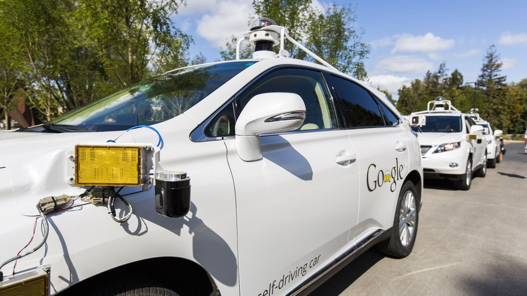

Slide 15
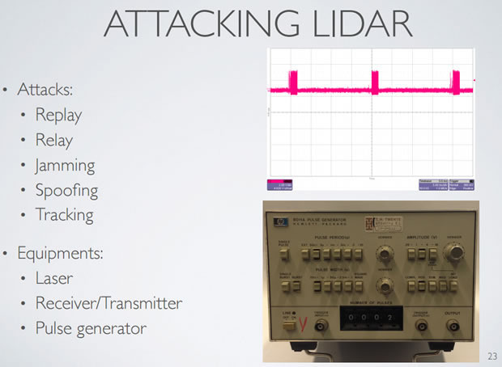

Slide 16
2. Attacks exploiting the vulnerabilities in various sensors of vehicle
2.4. Monoscopic and Stereoscopic Cameras
Cameras are used to detect lane detection, traffic sign recognition, headlight detection, obstacle detection, etc. Functioning of cameras can be partially disabled by using high beam torches or headlights of the opposite vehicles. It may introduce the safety concerns like false detection or not detection of the objects. Complementary metal oxide(CMOS) sensors used in the camera can be blinded by the high-power lights.

Slide 17
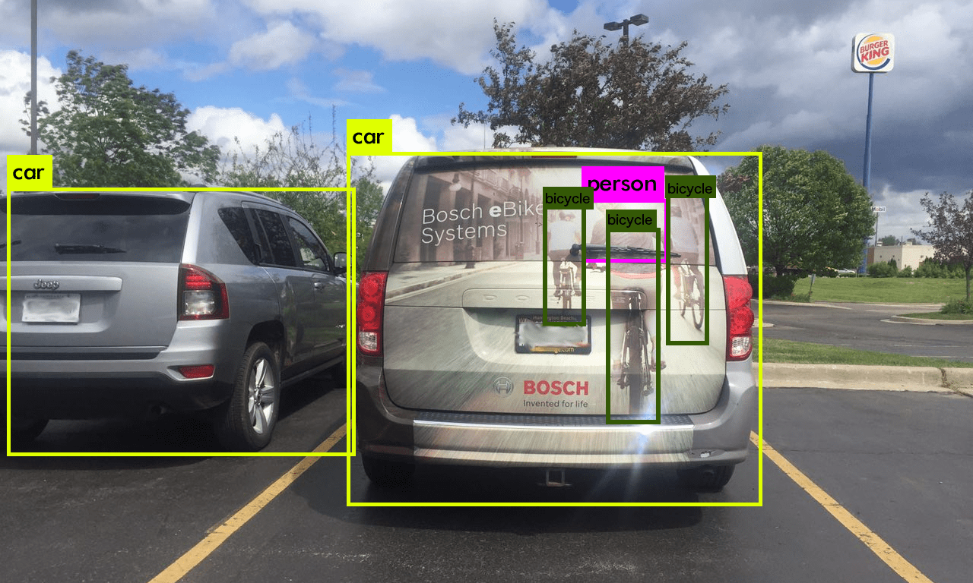

Slide 18
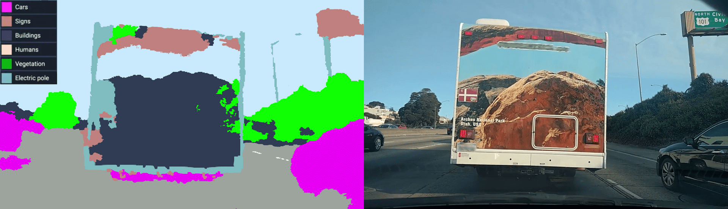

Slide 19
3. Vehicular Adhoc Network (VANET) attacks
Properties of Attacker
Insider: This type of attacker is an authentic user of the network and have detail knowledge of the network. If the attacker is a member node who can communicate with other members of the network, it will be known as an Insider and able to attack in various ways.
Outsider: The outsider attacker is a kind of intruder which aims to misuse the protocols of the network and range of such attacks are limited which means less variety of attacks.
Coverage Area: When any kind of attack is being launched coverage area act as a main property of the attacker. It depends on the nature of the attacker it can cover the main area of the road.
Technical Expertise: It is the most powerful property of the attacker that makes attacker more stronger for creating attacks in the network.
Resources: The three main characteristics on which attacker depends to achieve their goal are budget manpower and tools.

Slide 20
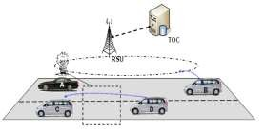
Properties of Attacker
Denial of Service Attack: It is the most serious level attack in vehicular network. In this attack attacker jams the main communication medium and network is no more available to legitimate user.

Slide 21
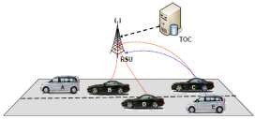
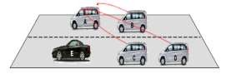
Properties of Attacker
Distributed Denial of Service Attack (DDOS Attack): DDOS attacks are those attacks in which attacker attacks in distributed manner from different locations. Attacker may use different timeslots for sending the messages. Nature and time slot of the message can be varied from vehicle to vehicle of the attackers. The aim of attacker is same as DOS attack.
V2V DDos
V2I DDos

Slide 22
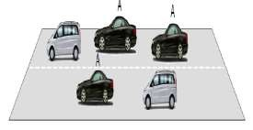
Properties of Attacker
Sybil Attack: It is a critical attack. In this kind of attack attacker sends multiple messages to other vehicles. Each message contains different source identity. It creates confusion to other vehicles by sending wrong messages like traffic jam. So there is jam further and vehicles are forced to take another route. The main aim of the attacker is to provide an illusion of multiple vehicles to other vehicles so that vehicles can choose another route.

Slide 23
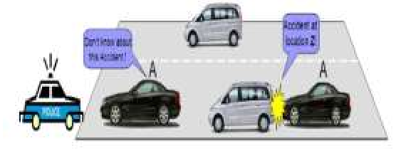
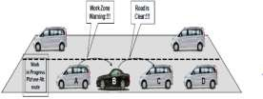
Properties of Attacker
Node Impersonation Attack: In vehicular network each vehicle has unique identifier which is used to verify the messages whenever the accident occurs by sending the wrong messages to other vehicles.
Application Attack: The main motive of attacker in this kind of attacker in this kind of attack is to content that are related to safety and non safety related applications. Safety applications play very important role as they provide warning messages to other users. In this attack the attackers alter the contents of the actual message and send wrong messages to other users

Slide 24
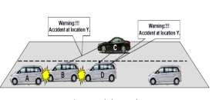
Properties of Attacker
Timing Attack: The main objective of attacker is to add some time slot in the original message that creates delay in the original message and these messages are received after these requires a time. AS we know safety applications are time critical applications if delay occurs in these applications then major objective of these applications is also finished.

Slide 25
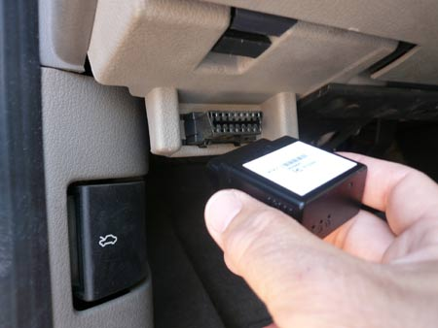
4. Hardware attacks and exploits
4.1. OBD port based attack
OBD stands for onboard diagnostics and OBD port is present in almost all the vehicles manufactured from 2008. OBD port is used for collecting the diagnostics data of the vehicle. It gives the data about the vehicle faults and performance. It interacts with the ECU’s communicating through CAN bus.
4.2. ECU Firmware tampering attack
ECU (Engine control unit) is a electronic control module for the sensors and actuators of any sub-system in a vehicle and a typical vehicle consists of more than 100ECU’s. ECU code is propitiatory making it safe and secure but attackers started targeting recent attacks by re flashing the ECU with custom firmware altering its state and inducing malicious and unintended actions. It is called a direct access attack as we assume that attacker has physical access to the ECU.

Slide 26
4.3. Rogue updates
Firmware updates in the connected cars are one of the sources for the Rogue updates. These updates are not from the manufacturer and lack of proper updates with safety and security. they are prone to the severe cyber attacks which leak private data of the vehicle. It allows hackers to provide enough security weakness to introduce malware and control the firmware of the connected cars.
4.3.1. Physical Access
Hackers can directly exploit the sensor data, control and communication modules. The attacks can be direct or indirect attacks targeting vehicular electronic modules or overloading effect on the physical layer.
4.3.2. Remote Access
Remote Access can be done through different connections like WiFi, Bluetooth, 4G, etc. ECU’s are directly connected to the CAN bus which is not intended. Connectivity to internet leads to the potential threat of injecting malware or virus files into the firmware.

Slide 27
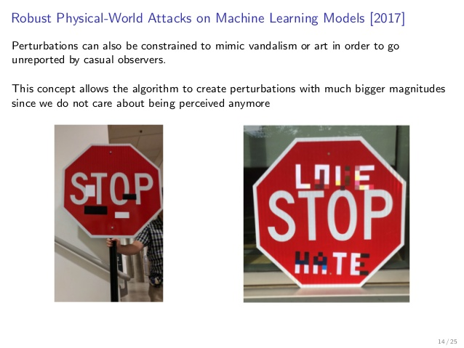
5. Adversarial Attacks on Autonomous vehicles

Slide 28
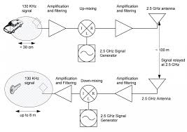
6. Miscellaneous Attacks
Gaining access to keyless entry system by spoofing, Malware attacks and applications that installed in the infotainment and navigation systems. New types of attacks like attacking the electric vehicle by exploiting the electric charger which is connecting and logging the data.
https://www.kaspersky.com/blog/electric-cars-charging-problems/20652/

Slide 29
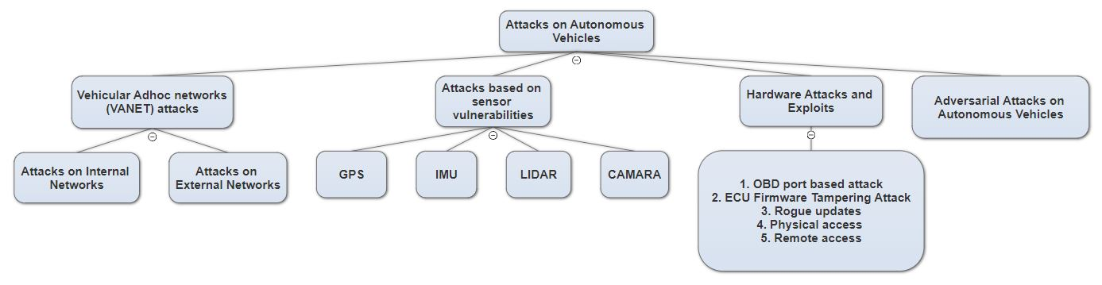
7. Conclusion
As the autonomous vehicle development is growing with rapid pace but the security aspect of vehicle is not receiving deserved attention which may become a serious threat to autonomous vehicles. Researchers have to come forward to join hands for collaborating and proactively giving priority to cyber security at design and development stages.

Slide 30
References
[1] A. Chattopadhyay, K. Y. Lam, Security of autonomous vehicle as a cyber-physical system, in: 2017 7th International Symposium on Embedded Computing and System Design (ISED), 2017, pp. 1–6. doi:10.1109/ISED.2017.8303906.
[2] A. M. Wyglinski, X. Huang, T. Padir, L. Lai, T. R. Eisenbarth,K. Venkatasubramanian, Security of autonomous systems employing embedded computing and sensors, IEEE Micro 33 (1) (2013) 80–86. doi:10.1109/MM.2013.18.
[3] S. J. Plathottam, P. Ranganathan, Next generation distributed and networked autonomous vehicles: Review,
in: 2018 10th International Conference on Communication Systems Networks (COMSNETS), 2018, pp. 577–582.
doi:10.1109/COMSNETS.2018.8328277.
[4] S. Jafarnejad, L. Codeca, W. Bronzi, R. Frank, T. Engel, A car hacking experiment: When connectivity meets vulnerability, in: 2015 IEEE Globecom Workshops (GC Wkshps), 2015, pp. 1–6.doi:10.1109/GLOCOMW.2015.7413993.

Slide 31
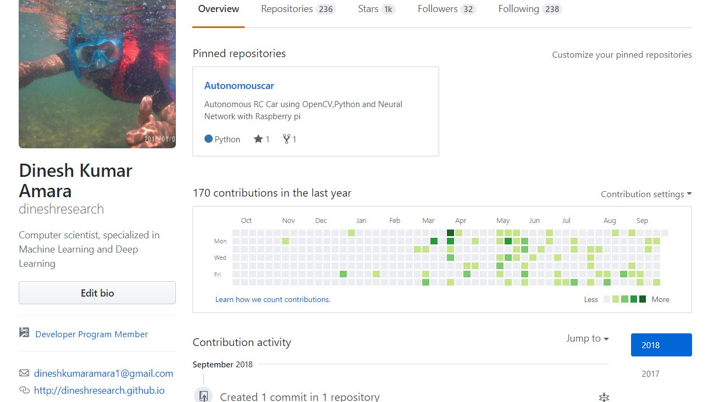
Follow me @ https://github.com/dineshresearch

